Slide 1
Starting A Home Vegetable Garden
A Seminar on Home Vegetable Gardening
Presented by VCE JCC/W Master Gardeners
Saturday, March 25, 2017

Slide 2
Starting A Vegetable Garden
Size Of Your Garden
Choosing A Spot For Your Garden
Constructing Your Garden
Choosing Vegetables To Grow
What, When And Where to Plant
Maintenance
Harvesting

Slide 3
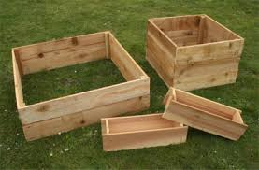
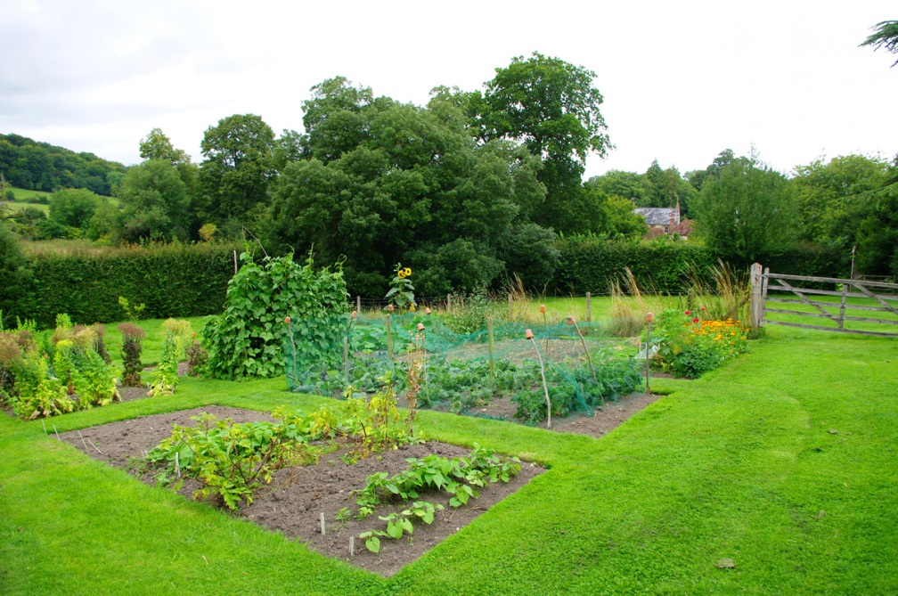
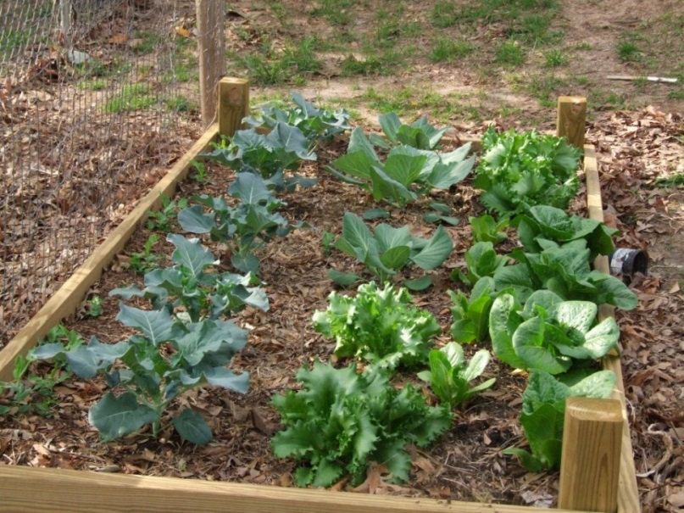
Determining Size Of Your Garden
Start small and scale up as you encounter success

Slide 4
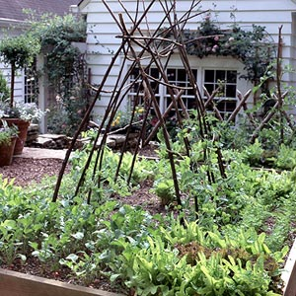
Locating Your Vegetable Garden
Put It Where The Sun Does Shine
(8-10 hours)
Proximity To Kitchen
Access To Water
(Rain Gauge)
Plan Ahead For Enough Room To Enlarge
Drainage And Level Ground
Away From Trees
Neighbors, Compost Area, Traffic

Slide 5
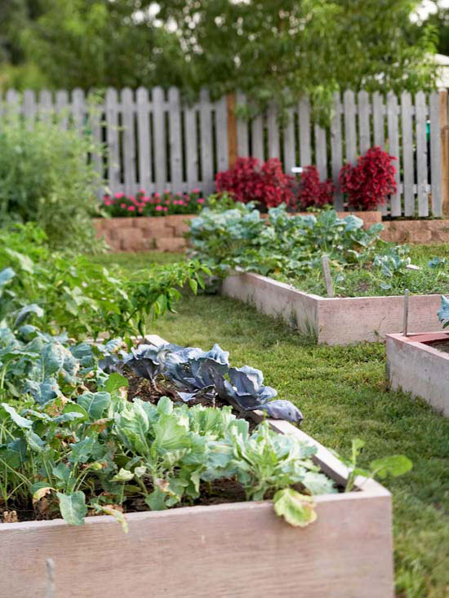
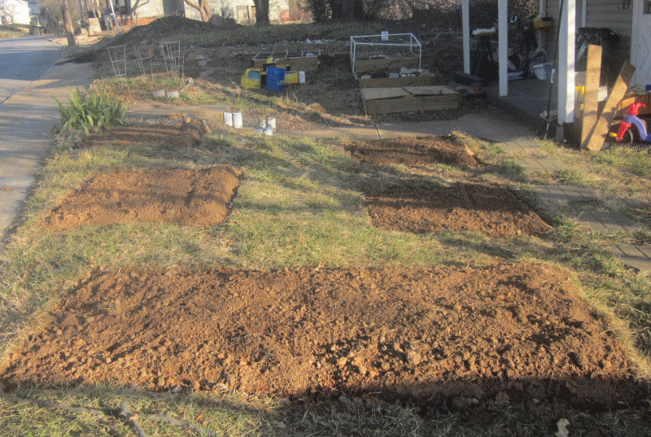
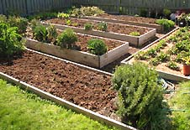
Building Your Garden
In Ground Garden vs Raised Beds

Slide 6
Building Your Garden
Advantages of Raised Beds
Improved soil drainage
Ease of access
Easier weed control
Less soil compaction
Warmer soil temperature in Spring
Reduced soil erosion
Increased vegetable production

Slide 7
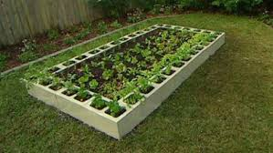
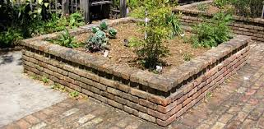
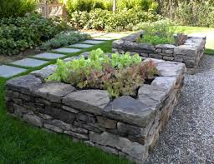
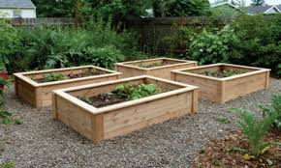
Examples of various types of raised beds

Slide 8
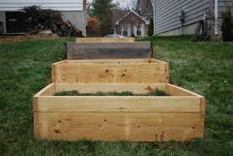
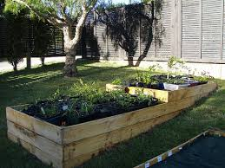
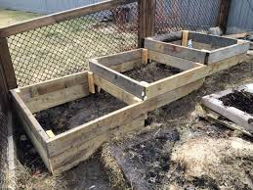
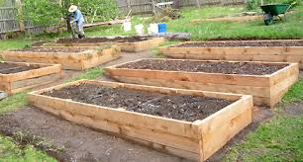
Raised beds on a slope

Slide 9
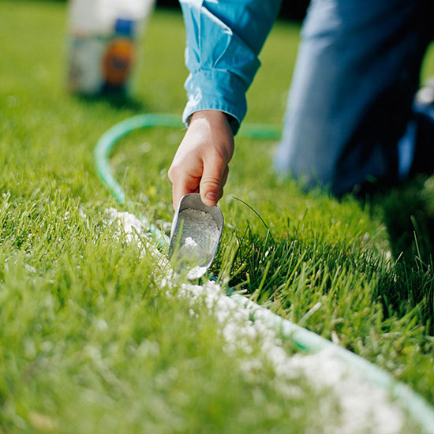
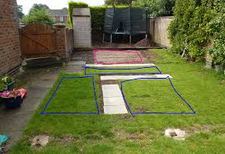
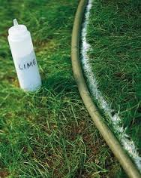
Marking Out The Garden

Slide 10
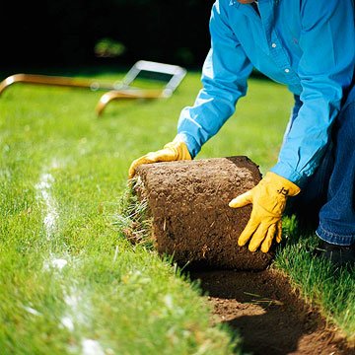
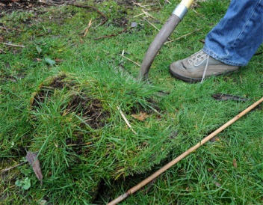
Preparing The Soil
Removing the Sod

Slide 11
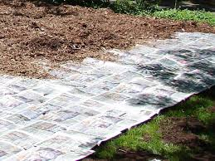
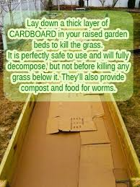
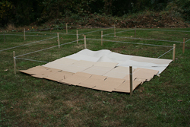
Preparing the Soil

Slide 12
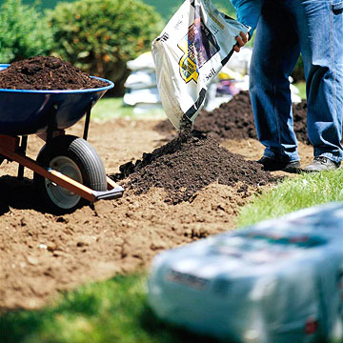
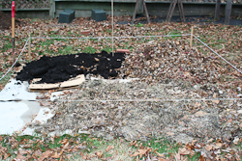
Add organic material:
Compost
Manure
Sphagnum peat moss
Shredded leaves
Decomposed grass clippings
Amending the soil

Slide 13
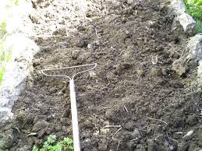
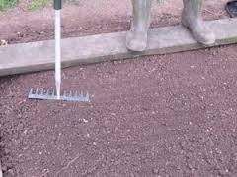
Preparing the Beds
Break up dirt clumps
Rake smooth and level
Firm seed bed soil
Prepare seed drill

Slide 14
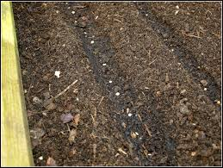
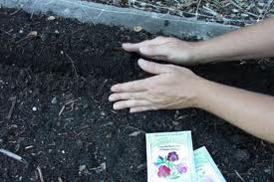
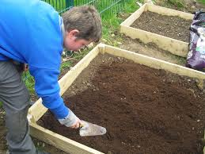
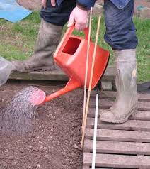
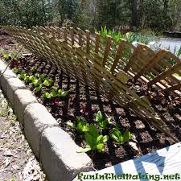
Sowing your Seeds
Carefully sow seed in drills (Spacing)
Cover seeds
Firm soil over seeds
Water gently
Shading

Slide 15
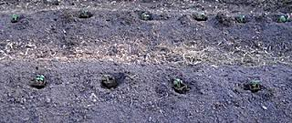
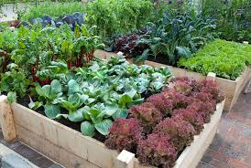
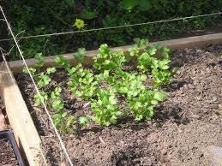
Using Transplants

Slide 16
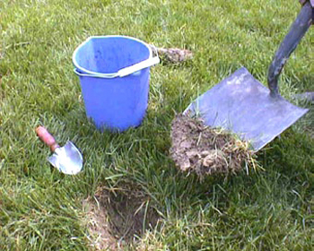
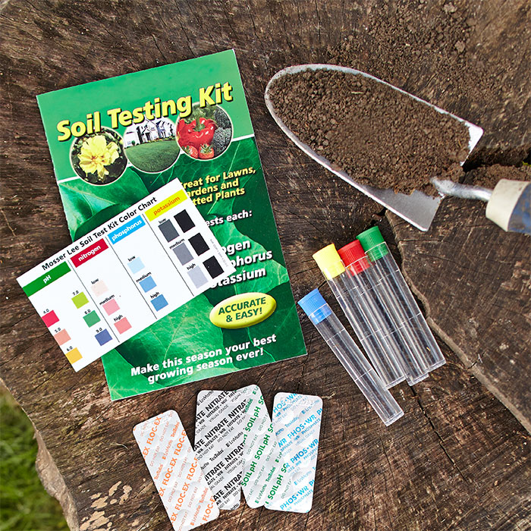
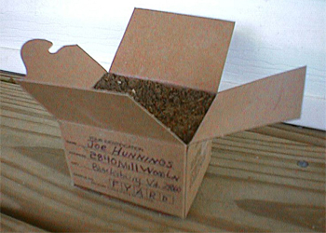
Testing the soil
Why is pH of soil important?
Nutrient availablility and transport
Ideal pH range 6.5 - 6.8
Low pH (acid soil) Add fast acting dolomite lime
High pH (alkaline soil) Add Ammonium Sulfate

Slide 17
YOUR GARDENING GOALS
Think, “What do you want to grow and eat?”
Start with vegetables you and your family like to eat.
Start small and scale up as you encounter success.
Start with easy to grow vegetables
Think “most bang for the buck”
(most flavor, convenience and dollar’s savings)
Productive Vegetable Crops
Beans, Bush
Beans, Pole
Broccoli
Carrots
Cucumber
Lettuce
Onions
Peppers
Squash, Winter
Tomato

Slide 18
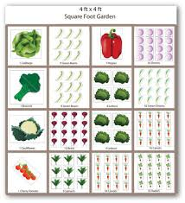
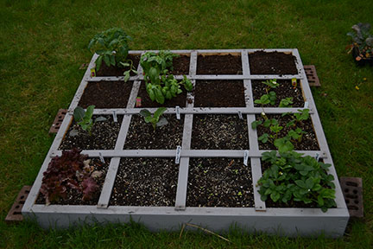
What To Plant, Where & When
Make a map of your garden.
Make the best use of the space.
Note location of the sun during the day.
Short plants on the south side of garden.
Tall plants on the north side of garden

Slide 19
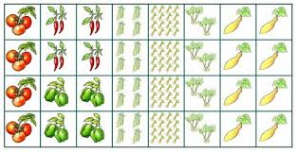
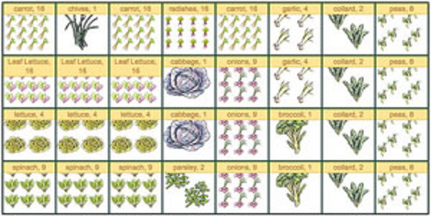
Garden Plans

Slide 20
Vegetable Plant Spacing
Vegetable | Space Between Plants
Green beans | 2-4 inches
Beets | 2-4 inches
Broccoli | 12-18 inches
Cabbage | 12-18 inches
Cauliflower | 12-18 inches
Cucumber | 12 inches
Eggplant | 18 inches
Lettuce, head | 10-12 inches
Lettuce, leaf | 2-4 inches
Vegetable | Space Between Plants
Onions | 2-4 inches
Peas | 1-3 inches
Peppers | 12-18 inches
Potato | 9-12 inches
Radishes | 1-2 inches
Spinach | 2-4 inches
Squash | 24 inches
Tomato | 18-24 inches
Turnips | 2-4 inches

Slide 21
Succession Planting: following one crop with another to maximize garden yield
Spring: Short Season
Can be planted in cool
In cool temperatures
Summer: Long Season
Warm temperatures
Fall: Can survive
Or thrive in cooling
temperatures
Bush beans
Pole beans
Lima beans
Cabbage
Sweet corn
Cucumbers
Eggplant
Muskmelon
Okra
Peppers
Potatoes
Pumpkin
Squash
Tomatoes
Watermelon
Swiss chard
Bush beans
Beets
Broccoli
Chinese cabbage
Carrots
Cauliflower
Endive
Kale
Kohlrabi
Radishes
Spinach
Turnips
Collards
Lettuce
Early beets
Early cabbage
Broccoli
Carrots
Onion sets
Lettuce
Snap peas
Radishes
Early spinach
Mustard
Turnips

Slide 22
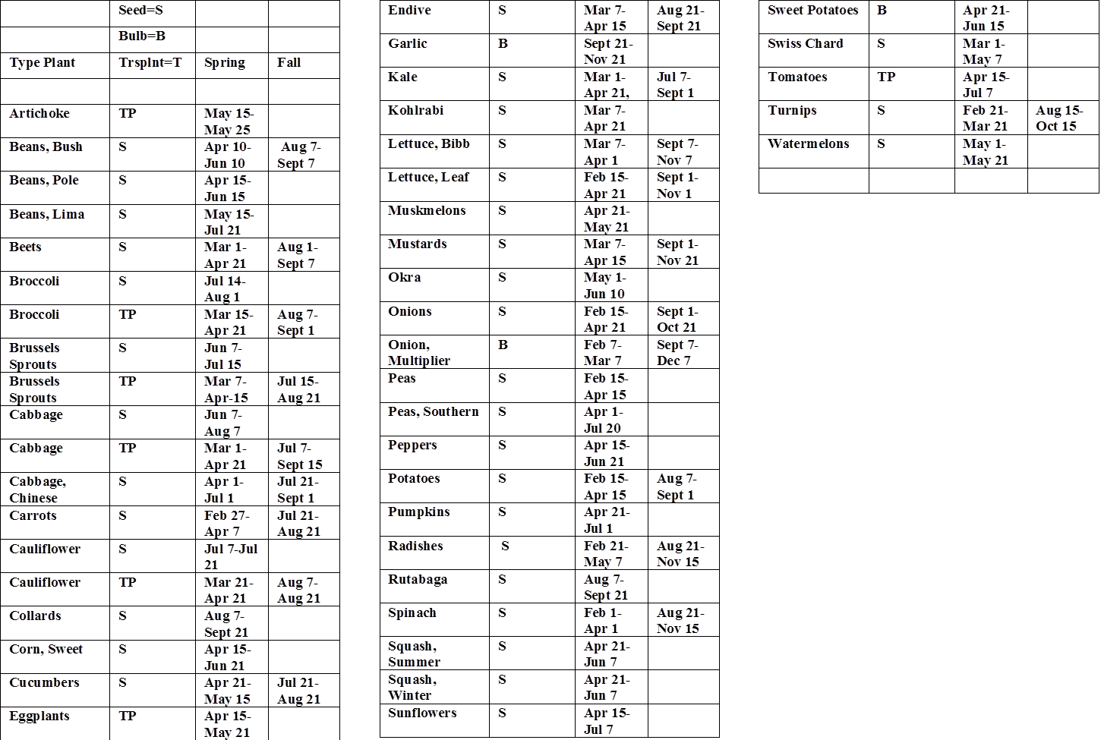
Vegetable Planting Dates Spring and Fall

Slide 23
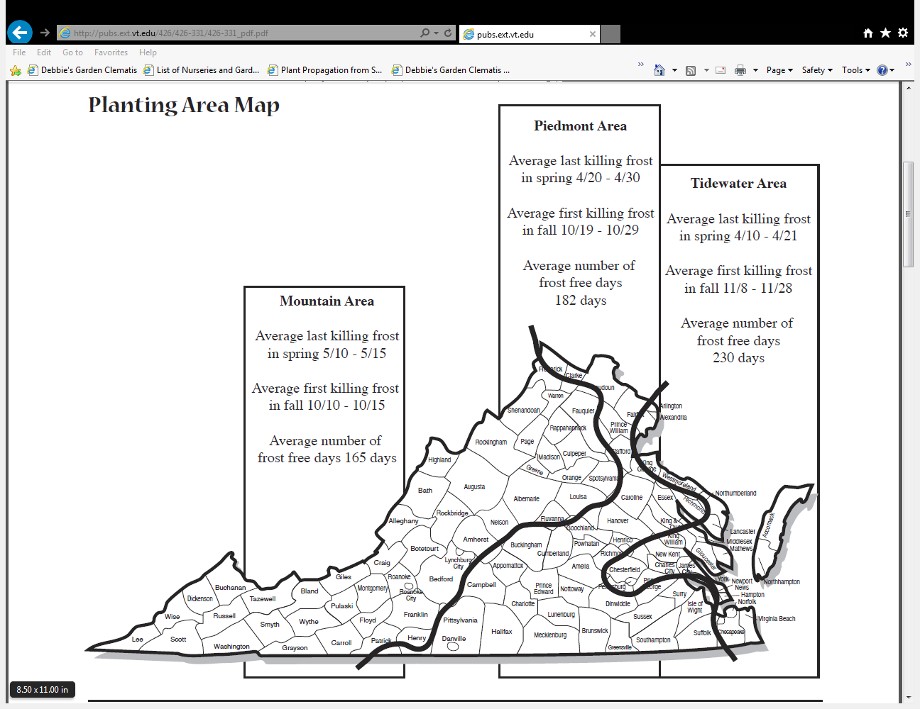

Slide 24
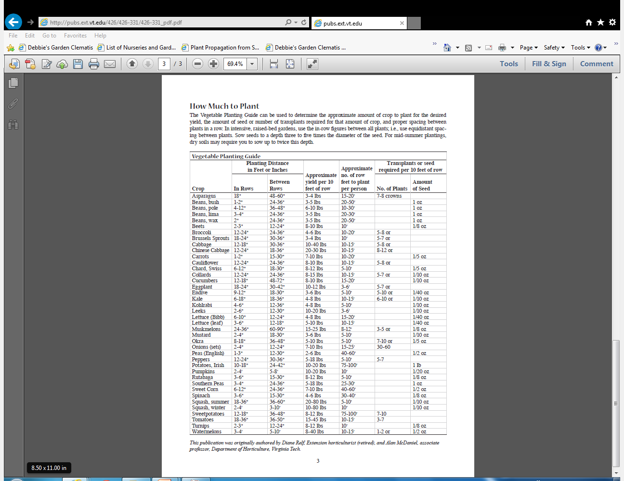

Slide 25
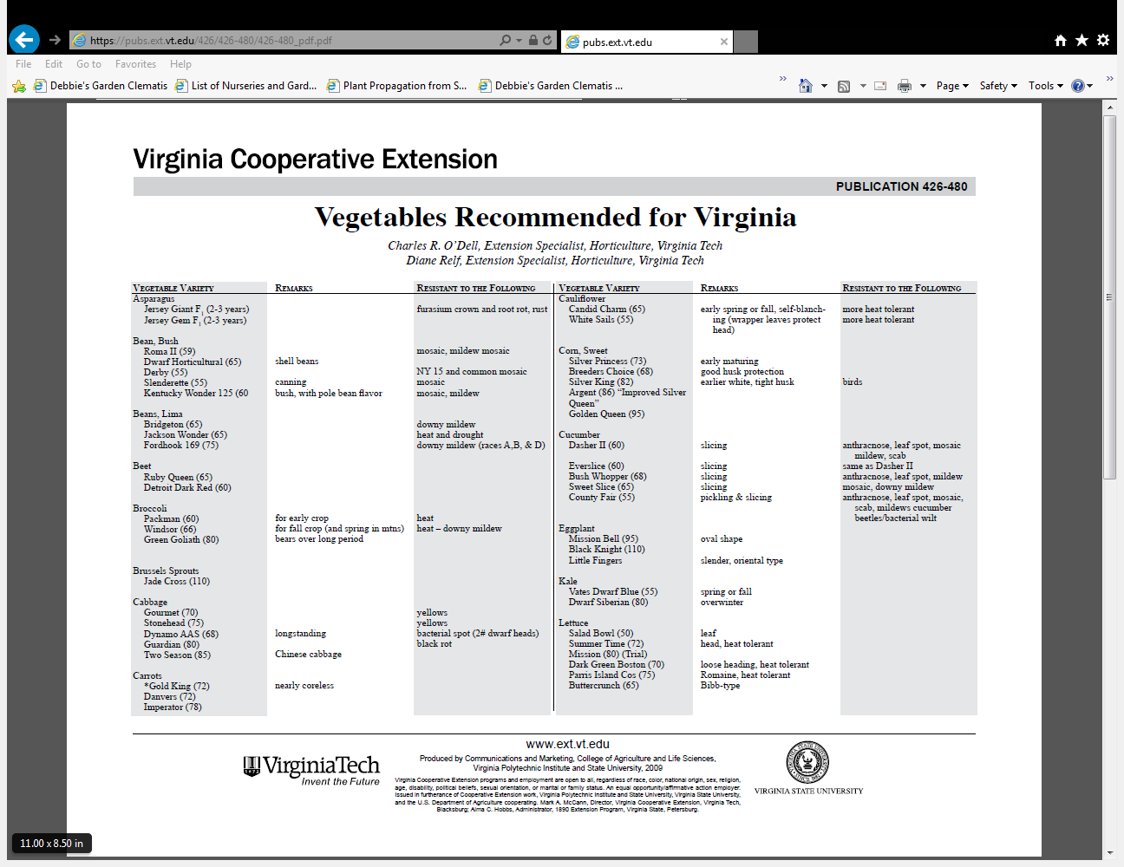

Slide 26
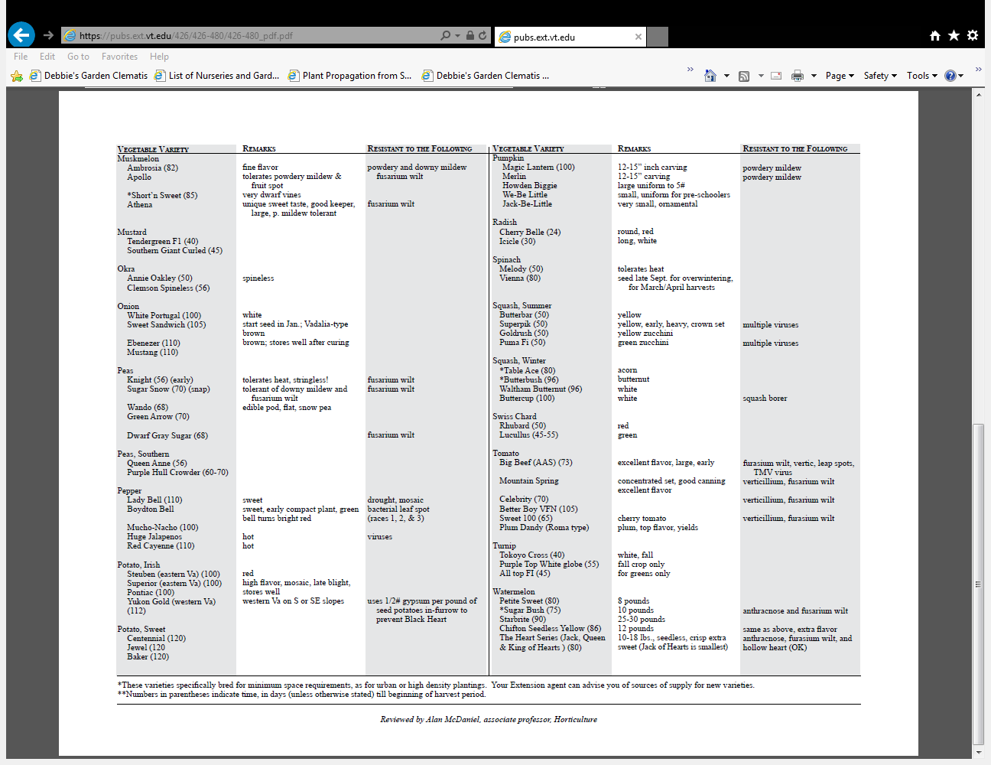

Slide 27
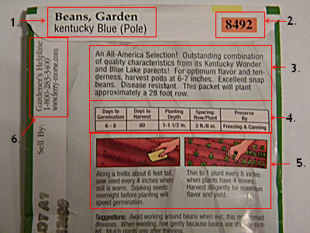
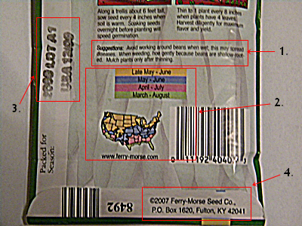
Reading the Seed Packet
Common, botanical and
cultivar name
Maturity date in days.
Number of seeds in package.
Date packaged.
Days to germinate.
Min. germination percentage.
Cultural information incuding:
Germination temperature.
Planting depth.
Light for germination Y/N.
Seed pretreatment:
Soaking
Scarification
Statification

Slide 28
SEED STARTING WORKSHEET 2015
SEED NAME SPECIES, CULTIVAR | SOURCE SEED CO | CAT # | SEED /PKT | WKS TO SET OUT | DA TO GERM | COVER SEED | DATE SEEDED | DATE TRNSPLD | NOTES:
Bean, Kentucky Wonder (pole bean) | Ferry Morse | 8492 | 50 | no | 6-8 | 1-1 ½ “ | 5/15 | no | Harvest 60 days

Slide 29
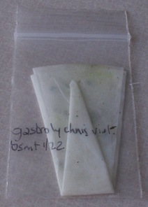
Pregermination
Germinating seeds before sowing

Slide 30
Protecting Your Garden

